Slide 1
FINDING COMPLEX ZEROS USING ZMAP
a Visual Algorithm
Bert G. Wachsmuth Dept. of Mathematics and Computer Science Seton Hall University

Slide 2
Intro to zMap

Slide 3
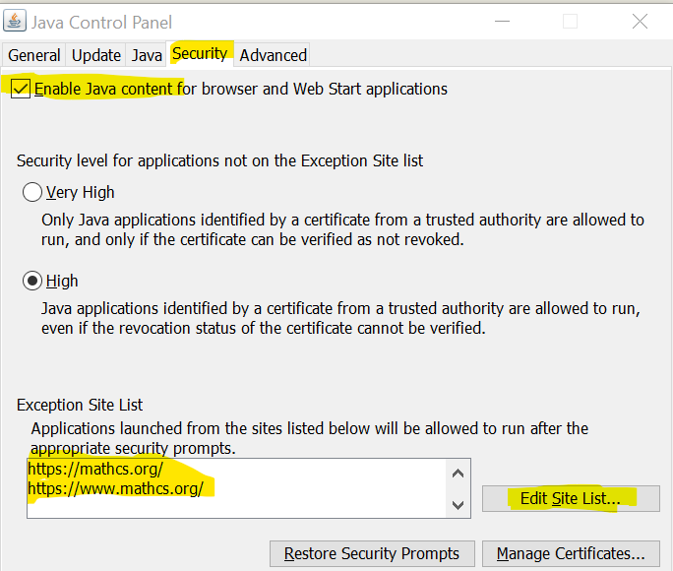
Configuring Java Security
(Instructions for Windows computers; similar for Mac and Linux) Configure Java. If necessary, download and install the Java JRE at https://www.java.com/en/download/
Press the Start button
Type “Configure Java”
Run the “Configure Java” Control Panel and click the “Security” tab
Make sure “Enable Java content …” is checked
Edit the Site List to add https://mathcs.org/ https://wwww.mathcs.org/
Click OK

Slide 4
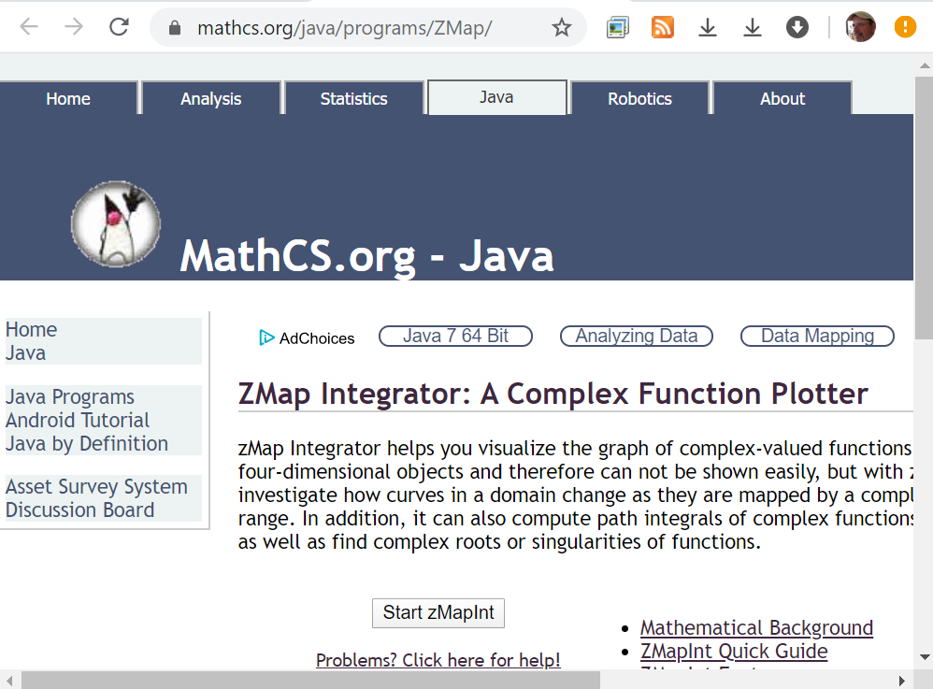
Running zMap (via Java Web Start)
Visit www.mathcs.org/java/programs/ZMap/
(Instructions for Google Chrome on Windows; similar for Firefox and Edge)
Click the “Start zMap” button
Click “Keep” when warning shows up that this file can harm your Computer” (it won’t - trust me)
Click on the downloaded file and zMap will download and execute
To run zMap subsequently, repeat the above, or execute the zMap web start file “ZMapInt.jnlp” directly from your “Downloads” folder, or add it to your “Start” Menu

Slide 5
zMap explained
zMap visualizes complex functions $f$ from the complex plane to itself.
The graph of such a function is a 4D object
On the left is the domain, on the right is the range
Control zMap through the Toolbar:
Enter the function
Select curve(s) to draw in the domain
Choose appropriate options
Watch how curves are transformed by $f$ in the range

Slide 6
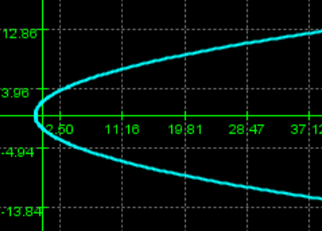
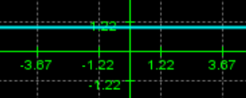
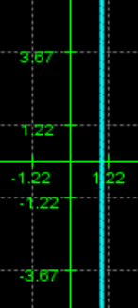
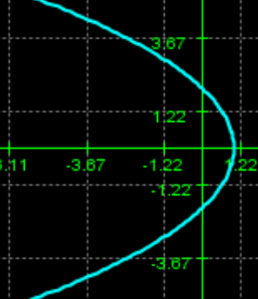
The Math behind zMap
Consider the function$f\left(z\right)=z^{2}$ and find the image of a vertical and a horizontal line though the point $z=1+i:$
horizontal line: $γ\left(t\right)=t+i$
$f\left(γ\left(t\right)\right)={\left(t+i\right)}^{2}=\left(t^{2}−1\right)+2it$
In the range we have $x=t^{2}−1$ and $y=2t$
Thus ${x=\left(\frac{y}{2}\right)}^{2}−1=\frac{y^{2}}{4}−1$ which is a sideways parabola opening up to the right
vertical line: $γ\left(t\right)=1+it$
$f\left(γ\left(t\right)\right)={\left(1+it\right)}^{2}=\left(1−t^{2}\right)+2it$
In the range we have $x=1−t^{2}$ and $y=2t$
Thus $x=1−{\left(\frac{y}{2}\right)}^{2}=1−\frac{y^{2}}{4}$ which is a sideways parabola opening up to the left
$z^{2}={\left(x+iy\right)}^{2}$
$z^{2}={\left(x+iy\right)}^{2}$

Slide 7
Limitations of this Approach
What would the situation look like for a function of a real variable, say $f\left(x\right)=x^{2}$
…. as x goes from $−∞$ down to 0 in the domain … … f(x) goes down from $+∞$ to 0 in the range …
…as x continues from 0 to $+∞$ in the domain … … f(x) reverses course and goes from 0 back up to $+∞$ in the range …
Only when domain and range ae drawn at right angles can we see the true graph (parabola). We can compensate somehow by introducing time: set the toolbar slider for zMap all the way to the right to see that the function $f\left(z\right)=z^{2}$ covers each parabola in the range twice.
To see the true (4D) graph of $f(z)$, we’d have to draw domain and range at right angles – alas, we can not!

Slide 8
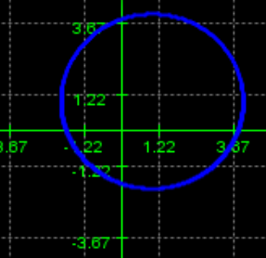
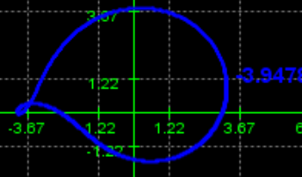
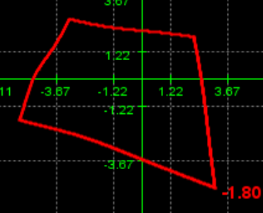
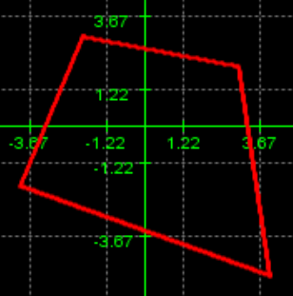
Integration along closed curves
In addition to finding images of curves to understand the graph of a complex function, zMap can find integrals along closed curves such as circles and boxes:
$\oint_{C_{1}}{\frac{z^{2}}{z−1}dz}$ where $C_{1}$ is the circle centered at $z=1+i$ with radius $2$
$\oint_{C_{1}}{\frac{z^{2}}{z−1}dz}=2πi$
$\oint_{C_{2}}{\frac{z^{2}}{z−1}dz}$ where $C_{2}$ is the box with vertices $−2+3i, −4−2i, 3+2i, 4−5i$
$\oint_{C_{2}}{\frac{z^{2}}{z−1}dz=2πi}$

Slide 9
Finding Zeros: the background
zMap can also find zeros of analytic functions and show them visually. The algorithm is based on the
Theorem: If $f(z)$ is analytic in a domain $D$ and $\oint_{C}{\frac{1}{f\left(z\right)}dz ≠0}$ for a simple, closed curve $C$ inside $D$,then $f\left(z_{0}\right)=0$ for at least one $z_{0}$ inside $C$.
Proof: Suppose not, i.e. $f(z)≠0$ for all $z$ inside the curve $C$. Then $\frac{1}{f(z)}$ is analytic inside the curve $C$. But then by Cauchy-Goursat’s theorem $\oint_{C}{\frac{1}{f\left(z\right)}dz=0}$, which is a contradiction.
Note: The opposite is not true. For example
$$\oint_{C}{\frac{1}{z^{2}−1}dz=2πi −2πi=0}$$
where C is circle radius 2 (of course you could also use zMap to verify that the integral is indeed zero) but $z^{2}−1$ has two zeros

Slide 10
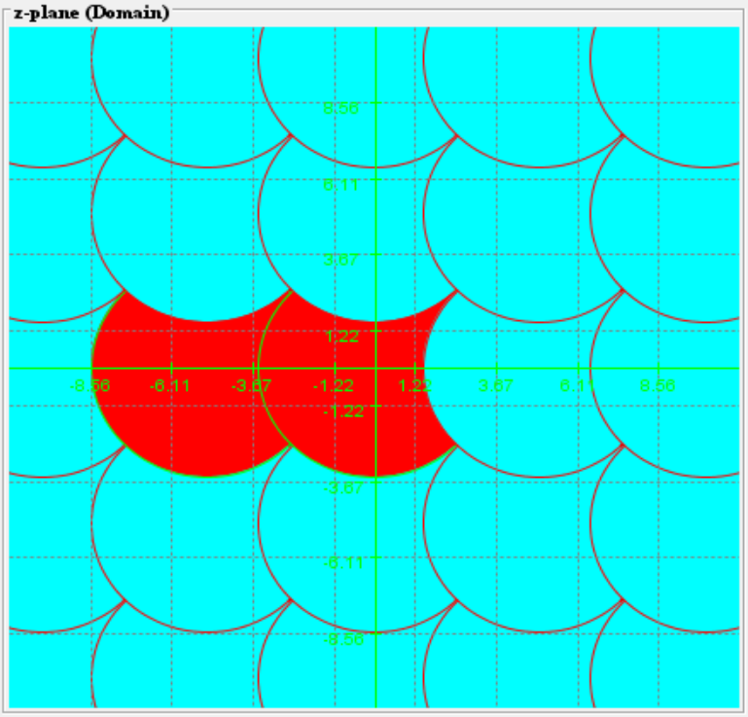
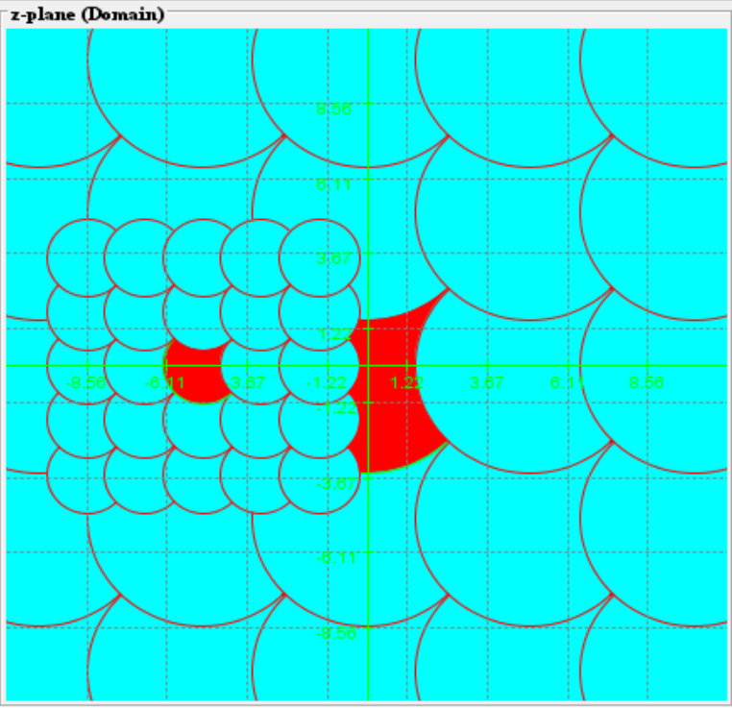
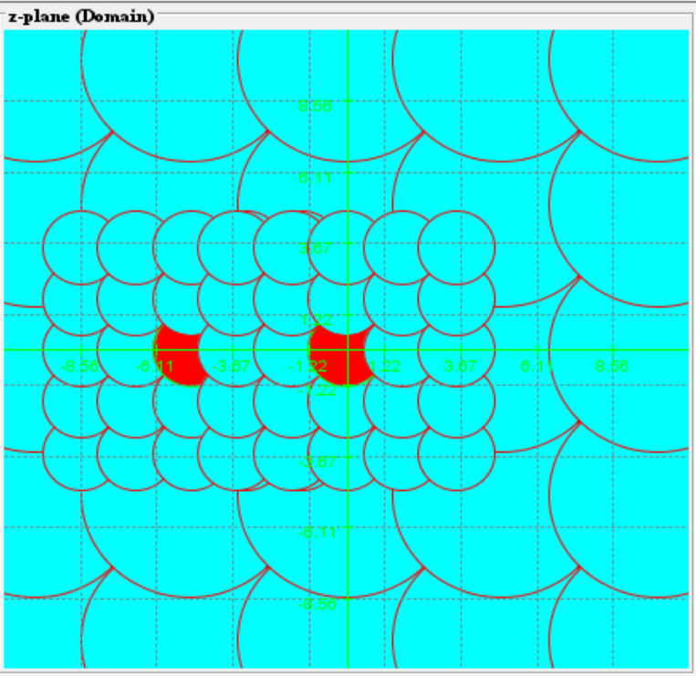
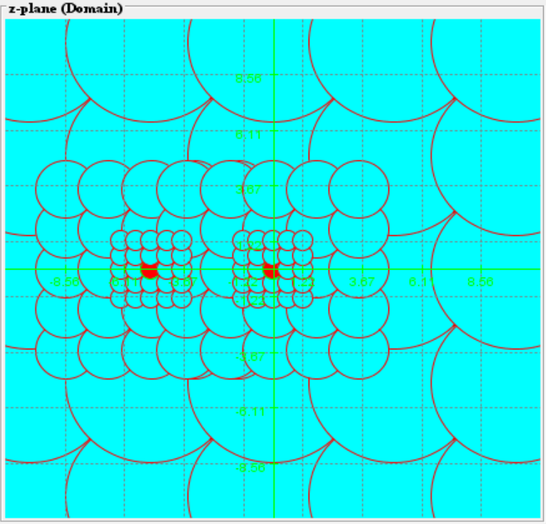
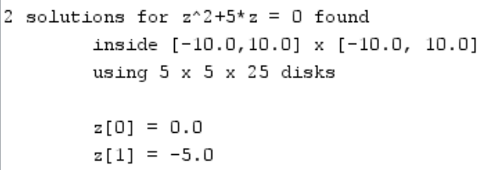
Finding Zeros: an Algorithm
Find all zeros of ${f\left(z\right)=z}^{2}+5z=0$
inside [-10,10] x [-10,10]
Cover the set by 5 x 5 disks
Compute $\oint_{∂D}{\frac{1}{f\left(z\right)}dz}$ for each disk
If integral is not zero, color the disk red and add it to a candidates queue. Also check whether $f\left(z_{0}\right)=0$is zero, where $z_{0}$ is the center of a red disk.
Otherwise, if the integral is zero, color the disk (light) blue
If the candidate queue is not empty, remove one of the (red) disk and repeat
Stop if the candidate queue is empty or if you completed $N_{max}$ iterations
n=1
n=2
n=3
n=5

Slide 11
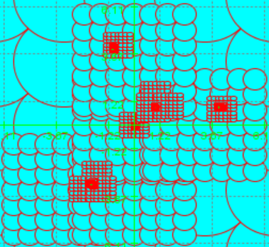
More Examples for Finding Zeros
Consider $f\left(z\right)=z\left(z−\left(1+i\right)\right)\left(z−\left(−2−3i\right)\right)\left(z−\left(4+i\right)\right)\left(z−\left(−1+4i\right)\right)=$
$$=z^{5}−\left(2+3i\right)z^{4}−iz^{3}−\left(66−9i\right)z^{2}+\left(67+55i\right)z$$
Consider $f\left(z\right)=\left(z−1\right)\left(z−0.1\right)\left(z−0.01\right)\left(z−0.001\right)$
To pick up the 4th root takes e.g. 12 x 12 disks and 20,000 iterations (and fine- tuning the epsilons)

Slide 12
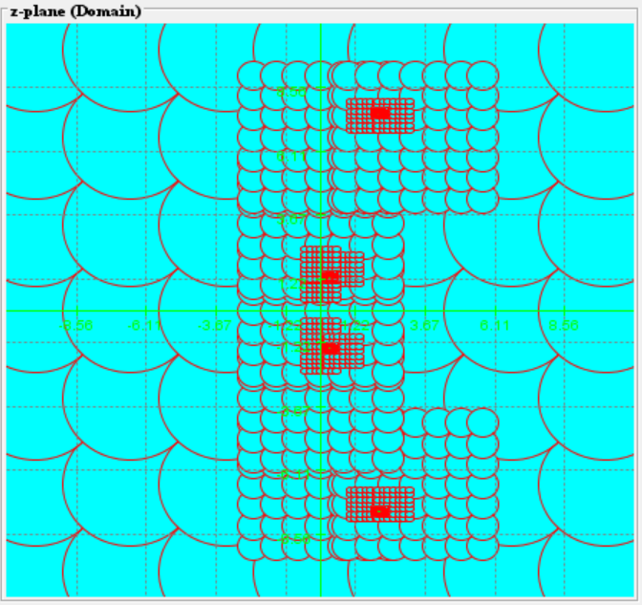
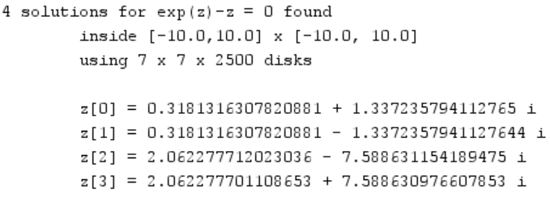
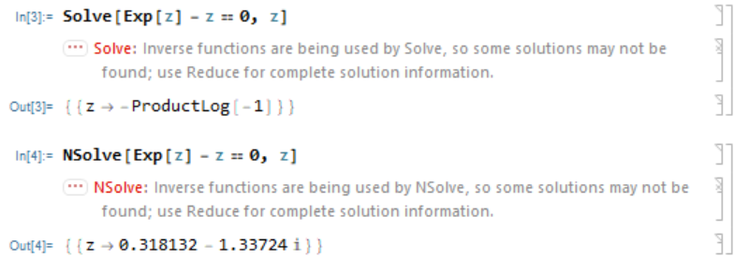
zMap versus Mathematica
Consider $f\left(z\right)=e^{z}−z$
Mathematica’s answer:

Slide 13
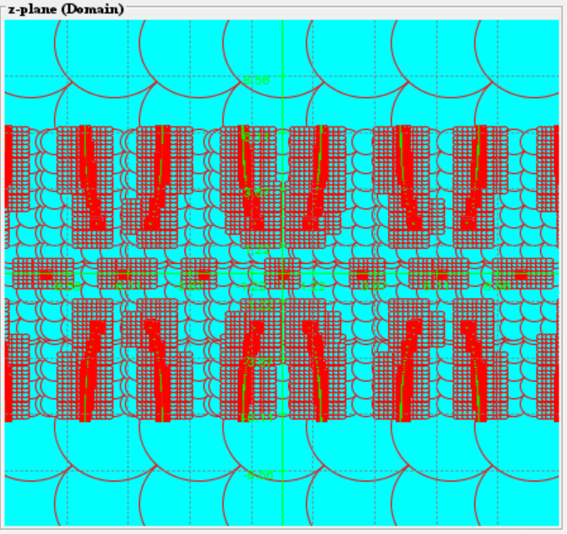
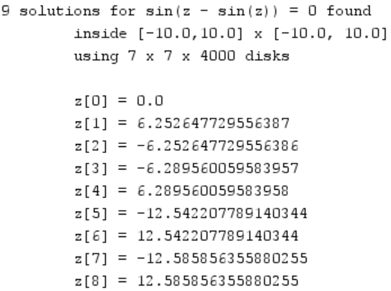
Chromosomes are the Solution
Consider $f\left(z\right)=\sin\left(z−\sin\left(z\right)\right)$
Mathematica’s answer:

Slide 14
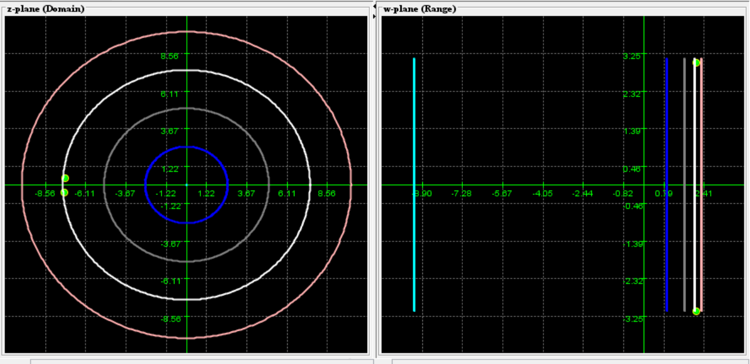
Example 1: $f(z) = ln⁡(z)$ is not continuous along the negative real axis $\{x<0, y=0\}$
Show that the complex Log function is not continuous along the negative real axis
We use f(z) to draw the image of several circles around the origin with increasing radii.
You can see that the complex logarithm maps circles to vertical lines
We can find two points on either side of the negative real axis that are close together but their images remain far apart
Thus, ln(z) can’t be continuous along the negative real axis

Slide 15
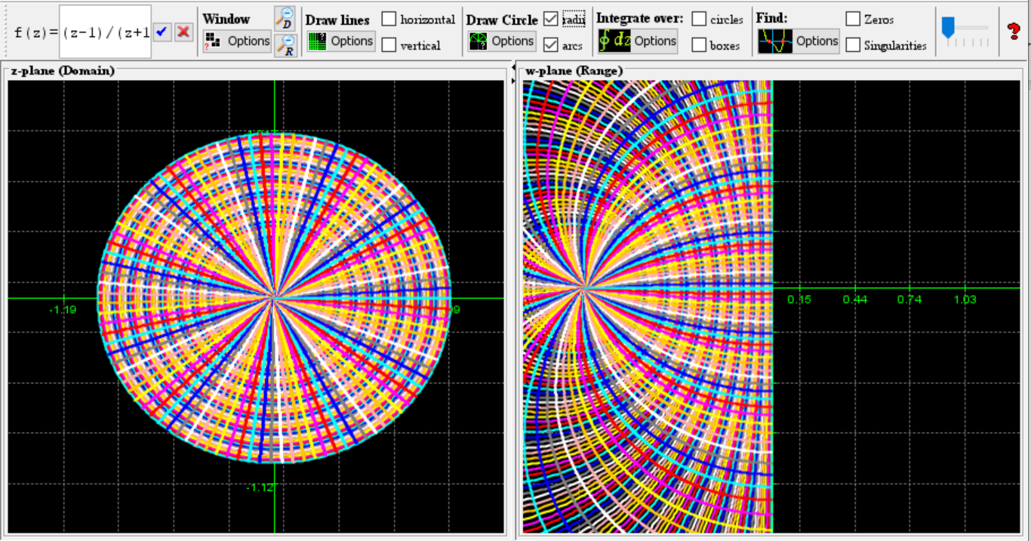
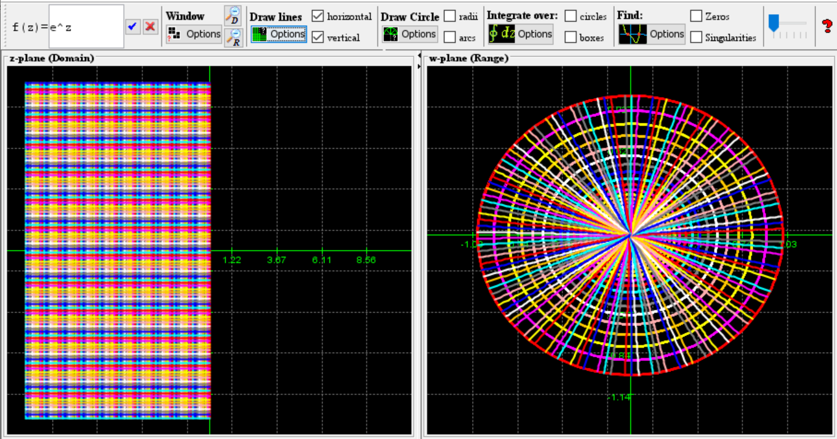
Example 2: Find a Function $f:D→D$, where $D=unit disk$
Consider $f\left(z\right)=e^{z}$ and $g\left(z\right)=\frac{z−1}{z+1}$
We use zMap to find out about $f$ and $g$ that:
$f\left(z\right)=e^{z}$ maps the left half plane onto the unit disk
$g\left(z\right)=\frac{z−1}{z+1}$ maps the unit disk onto the left half plane

Slide 16
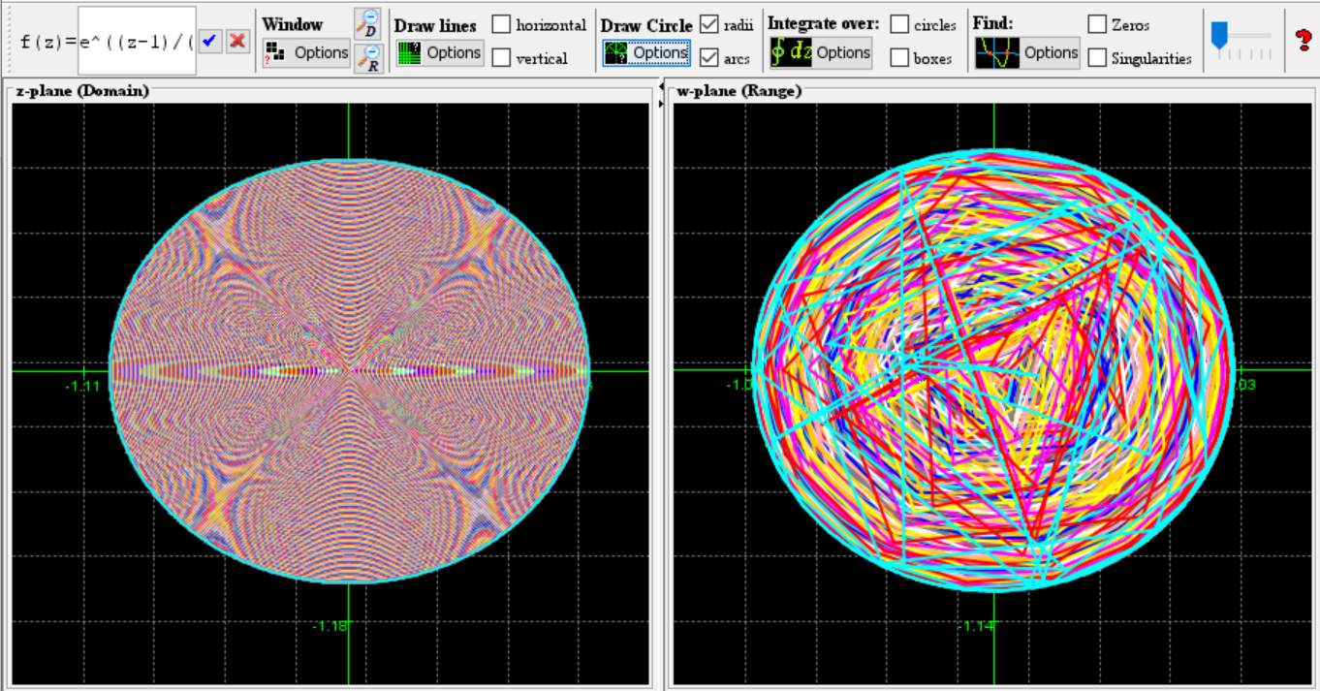
Example 2 cont’d
Therefore the composition $\left(f ° g\right)\left(z\right)=e^{\frac{z−1}{z+1}}$ maps the unit disk onto itself

Slide 17
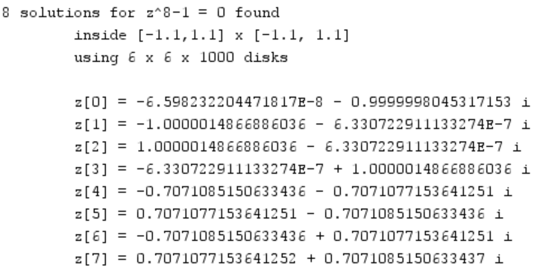
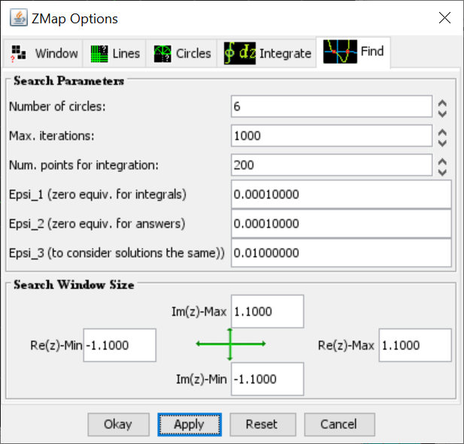
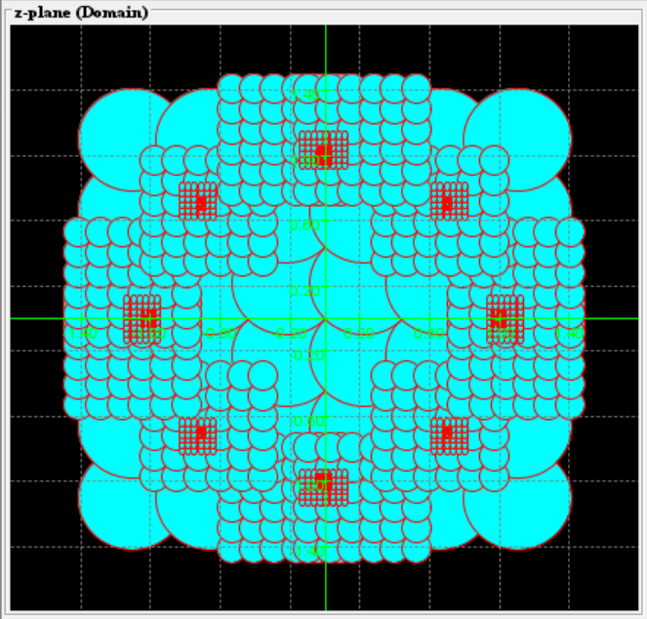
Example 3: Roots of Unity
Find the 8th roots of unity, i.e. all $z$ for which $z^{8}=1$ and describe their distribution.

Slide 18
Thank you
zMap – available at https://www.mathcs.org/java/programs
Source code available upon request wachmut@shu.edu
Sample problems available through zMap online help
Please do not forget to fill out the talk evaluation sheets

