Slide 1
Using Statistics for Better Business Decisions
Justin Bateh and Bert G. Wachsmuth
Copyright © Justin Bateh and Bert G. Wachsmuth, 2016. All rights reserved.

Slide 2
Chapter 9 Analysis of Variance
Using Statistics for Better Business Decisions
Copyright © Justin Bateh and Bert G. Wachsmuth, 2016. All rights reserved.

Slide 3
Learning Objectives
Use a factor to partition an experiment into multiple groups
Understand the assumptions to check before using a one-way ANOVA
Use the one-way ANOVA to test for differences among the means of several groups
Understand how to obtain information about two-factor ANOVA
Ch 9: Analysis of Variance – Learning Objectives

Slide 4
Example
Many parents complain that students listen to pop music while they study. To test the impact of music on students’ concentration levels, we divide 40 students randomly into three groups: Group A does not listen to any music, group B listens to pop music, and group C listens to classical music. All students study a text for 30 min and then they take a test about their understanding of the text.
Ch 9: Analysis of Variance – Introduction

Slide 5
Two types of variables in the example:
The performance of students on a test
First variable (quiz_score) is numerical
The type of music students listen to
Second variable (music_type) is categorical and is used to partition the first variable into three groups
This, as it turns out, is typical for an ANOVA test to compare multiple means.
Note that to decide whether multiple means of various groups are different from each other, we could use multiple difference of means tests between pairs of means, but that would quickly escalate.
Ch 9: Analysis of Variance – Introduction

Slide 6
For three groups we would need three comparisons:
${\text{m}}_{1}$ ≠ ${\text{m}}_{2}$, ${\text{m}}_{1}$ ≠ ${\text{m}}_{3}$, and ${\text{m}}_{2}$ ≠ ${\text{m}}_{3}$
For four groups we would need six comparisons:
${\text{m}}_{1}$ ≠ ${\text{m}}_{2}$, ${\text{m}}_{1}$ ≠ ${\text{m}}_{3}$, ${\text{m}}_{1}$ ≠ ${\text{m}}_{4}$, ${\text{m}}_{2}$ ≠ ${\text{m}}_{3}$, ${\text{m}}_{2}$ ≠ ${\text{m}}_{4}$, and ${\text{m}}_{3}$≠ ${\text{m}}_{4}$
For five groups we would need 10 comparisons, and so on.
Ch 9: Analysis of Variance – Introduction
Notes:
This quickly becomes a lot of work.
In addition—and perhaps more important—each time we conduct a difference of means test we accept an error, typically 5 percent.
These errors add up, approximately, so that checking three group means would add up to an error of 15 percent.
Thus, we need a new procedure that keeps the error at a constant level even if we are comparing quite a number of means.

Slide 7
ANOVA Procedure
Used to test for a significant difference among a group of means
The null hypothesis: $H_{0}$: ${\text{m}}_{1}$= ${\text{m}}_{2}$ = … = ${\text{m}}_{k}$
The alternative is that at least two means differ significantly:
$H_{a}$: ${\text{m}}_{j}≠$ ${\text{m}}_{i}$
Note that in case the ANOVA procedure is used for only two means it should reduce to a difference of means test.
The procedure works by comparing the variance ${SS}_{B}$ between group means against the variance ${SS}_{W}$ within groups to determine whether the groups are all part of one larger population (no difference between means) or separate populations with different characteristics (at least two means differ significantly).
Ch 9: Analysis of Variance – Introduction
Notes:
Note that in case the ANOVA procedure is used for only two means it should reduce to a difference of means test. It might sound strange for a procedure that claims to test for differences of means to be called ANOVA. However, it turns out that we can analyze the variances yet draw conclusions about any difference of means.

Slide 8
One-Factor ANOVA
Suppose we have quiz scores of students in a statistics course:
2 (male), 5 (female), 1 (male), 3 (male), 6 (female), 7 (female)
We want to know if there is a difference in mean scores between males and females.
Since these represent two samples only, we could use our familiar difference of means test (which incidentally results in a t-value of t = -4.0 and a p-value of p = 0.016) but we want to use a different method that will readily extend to more than two groups and their means.
First, we use sex to divide the scores into two groups, as follows.
Male | Female
2 | 6
1 | 5
3 | 7
Ch 9: Analysis of Variance – One-Factor ANOVA

Slide 9
The variable we are interested in analyzing is called the dependent variable
The variable we use to divide the dependent variable into groups is called the independent variable or factor
For ANOVA, the dependent variable should be numerical while the factor should be categorical.
A single-factor ANOVA uses one factor to divide the dependent variable into groups.
Ch 9: Analysis of Variance – One-Factor ANOVA

Slide 10
For a single-factor ANOVA we will assume that all groups are approximately normal with roughly the same standard deviations.
In the preceding example we are using one factor (sex) to define the groups; consequently we will perform a single-factor ANOVA.
Both groups have sample variances of 1, as you can readily compute.
The samples are really too small to check for normality but for this example we will simply assume everything is normal.
If the variable used as factor had more values (categories), it would result in that many groups; still it would be a single-factor ANOVA.
Ch 9: Analysis of Variance – One-Factor ANOVA

Slide 11
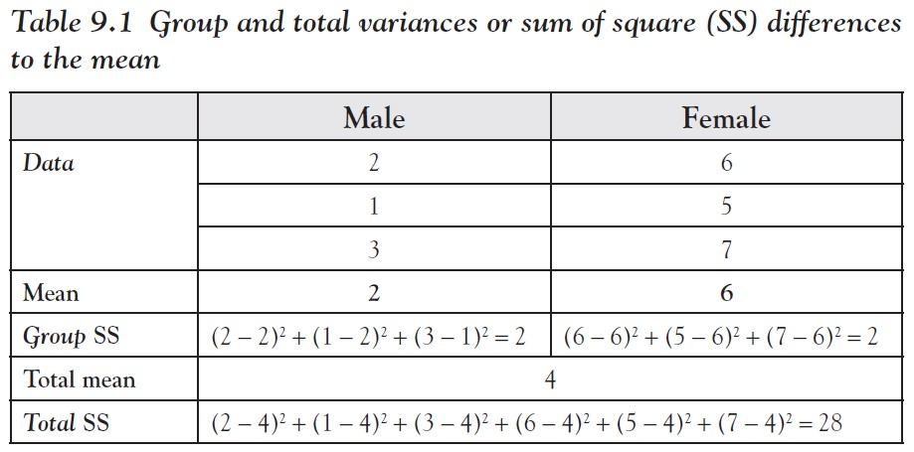
We now compare the variance of our overall data with the variances of each group.
Since the variance is a function of the square difference of each point to the respective mean, we compute only the sum of the square differences to the mean instead of the full variance.
Ch 9: Analysis of Variance – One-Factor ANOVA

Slide 12
The means for the two groups are quite different.
The sums of square differences within each group are 2.
Adding them together, we get ${SS}_{W}$ = 4.
If we ignore group membership and compute the total sum of square differences ${SS}_{T}$ based on the overall mean 4, we get ${SS}_{T}$ = 28.
In other words, the variance (aka sums of squares) ${SS}_{W}$ within the groups is much smaller than the total variability ${SS}_{T}$, which indicates that the means are indeed different.
Ch 9: Analysis of Variance – One-Factor ANOVA

Slide 13
More precisely, under the null hypothesis that there are no mean differences between groups in the population, we would expect only minor random fluctuation in the means of the two groups.
Therefore, under the null hypothesis, it turns out that the variance ${SS}_{W}$ within groups divided by the degree s of freedom within groups should be about the same as the variance ${SS}_{B}$ between groups divided by the degrees of freedom between groups.
We can compare those expressions via the F distribution and test whether their ratio is significantly greater than 1.
Ch 9: Analysis of Variance – One-Factor ANOVA

Slide 14
Single-factor ANOVA
Suppose we have k groups and each group contains $n_{j}$ measurements, 1 ≤ j ≤ k
Assume that all groups are approximately normal and that their standard deviations are approximately the same.
The four components of a single-factor ANOVA are:
$H_{0}$: ${\text{m}}_{1}$= ${\text{m}}_{1}$ = … = ${\text{m}}_{k}$
$H_{a}$: ${\text{m}}_{i}≠$ ${\text{m}}_{j}$ for some i, j
Ch 9: Analysis of Variance – One-Factor ANOVA
Notes:
Here is the formal definition of a single-factor ANOVA.

Slide 15
Single-factor ANOVA
Test statistics:
where ${df}_{B}$ = k – 1, ${df}_{W}$ = ($n_{1}$ – 1) + ${(n}_{2}$ – 1) + … + ${(n}_{k}$ – 1)
sum of squares within groups ${SS}_{W}= {SS}_{1}$ + ${SS}_{2}$ +… + ${SS}_{k}$
the total sum of squares ${SS}_{T}$
the sum of squares between groups ${SS}_{B}$ = ${SS}_{T} − {SS}_{W}$
Rejection region: Reject $H_{0}$ if p = P(f >$f_{0}$) < a
where p = P(f >$f_{0}$) = FDIST($f_{0}$,${df}_{B}$,${df}_{W}$) using the F distribution
Ch 9: Analysis of Variance – One-Factor ANOVA
Notes:
Here is the formal definition of a single-factor ANOVA.

Slide 16
Now we can finish the preceding example:
${df}_{B}$ = 2 – 1 = 1
${df}_{W}$ = (3 – 1) + (3 – 1) = 4
${SS}_{T}$ = 28
${SS}_{W}$ = 2 + 2 = 4
${SS}_{B}= {SS}_{T} −$ ${SS}_{W}$ = 28 – 4 = 24
At this point we know the variance within groups ${SS}_{W}$as well as the variance between groups ${SS}_{B}$ so that
Hence, assuming as usual that a = 0.05, we reject the null hypothesis and conclude that there is a difference between the means.
Ch 9: Analysis of Variance – One-Factor ANOVA
Notes:
Incidentally, this would have been our conclusion had we used the difference of means procedure.
Now we are ready for a true ANOVA, that is, for an example with more than two groups.

Slide 17
Example
We want to determine if a new drug is effective in lowering blood pressure, and what dosage might work best. So we give three different levels of the drug (zero drugs, low amount, high amount) to 20 patients and measure the difference in blood pressure before and 30 min after administering the drug. The 20 people were randomly assigned to receive one of the three dosages.
The results are:
Zero dosage: 4, 1, 7, 8, 2, 10
Low dosage: 11, 15, 12, 13, 18, 16, 14
High dosage: 15, 17, 12, 13, 10, 11, 10
Is there a significant difference between the three averages? Test at the a = 0.05 level.
Ch 9: Analysis of Variance – One-Factor ANOVA

Slide 18
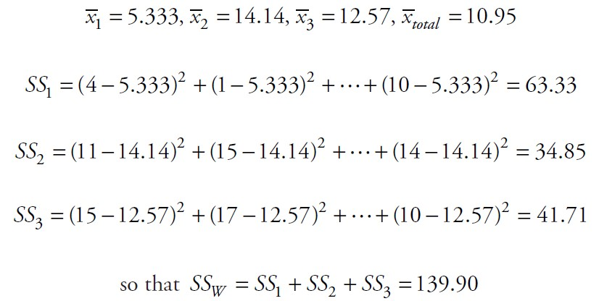
The computations for our ANOVA test:
Ch 9: Analysis of Variance – One-Factor ANOVA

Slide 19
Thus, we reject the null hypothesis and accept the alternative, that is, there is a significant difference between (at least two of ) the means.
Ch 9: Analysis of Variance – One-Factor ANOVA

Slide 20
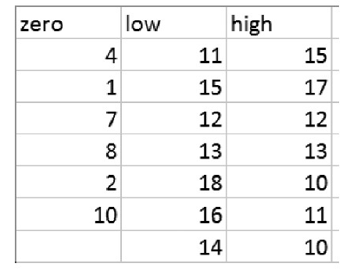
Example
Given the data from the previous example, use Excel to perform an ANOVA to decide whether the means differ significantly.
First, we enter the data into Excel in three columns, one column per group.
Figure 9.1 Data entered in columns for each group
Ch 9: Analysis of Variance – One-Factor ANOVA

Slide 21
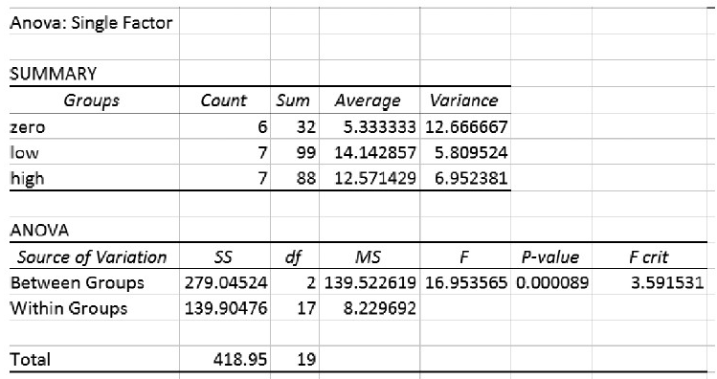
Click on the “Data Analysis” on the Data ribbon
Select “ANOVA: Single factor”
Define as input range the data you entered, including the data labels in the first row
Make sure that “Labels in First Row” is checked and hit OK.
Figure 9.2 Output of single-factor ANOVA routine
Ch 9: Analysis of Variance – One-Factor ANOVA

Slide 22
The SUMMARY block in Figure 9.2 shows the means and variances of the three groups.
In the more interesting ANOVA section we can see that ${SS}_{B}$= 279.04 and ${SS}_{W}$ = 139.90.
It lists the degrees of freedom next and finally shows the $f_{0}$ value of 16.95 together with the associated probability p = 0.000089, computed using the F distribution.
Our conclusion is, just as before, to reject the null hypothesis and accept that some means differ significantly from each other.
Ch 9: Analysis of Variance – One-Factor ANOVA
Notes:
We will show another, carefully worked out problem in the last section of this chapter; you can check that if you have any questions. You might want to work out that example manually, as we did earlier, and compare your answers.
But the idea of the ANOVA is even more powerful and applies to more complex experiments.

Slide 23
Two-way ANOVA
For more information:
Introduction to Probability and Statistics by Mendenhall, Beaver, and Beaver
Introduction to ANOVA/MANOVA at www.statsoft.com/Textbook/ANOVA-MANOVA
Analysis of variance at http://en.wikipedia.org/wiki/Analysis_of_variance
Ch 9: Analysis of Variance – Two-Way ANOVA
Notes:
As we mentioned, a one-factor ANOVA uses one categorical variable called factor to divide the dependent variable into groups. But complex situations often depend on more factors, which will result in two-way ANOVA or higher. As it turns out, the ANOVA procedure cannot only decide on whether means are different but detect interaction effects between variables, and therefore can be used to test more complex hypotheses about reality. As it turns out, in many areas of research five-way or higher interactions are not that uncommon.
However, this discussion is difficult and, while most certainly useful, is beyond the scope of this text. Thus, we will refer the reader to more advanced statistical textbooks, or better yet, appropriate online resources and we will not discuss two-way (or higher) ANOVA here.

Slide 24
Excel Demonstration
Company S, the accounting firm, has an HR department that has suggested managers learn different leadership styles to help decrease employee stress levels. An experiment was conducted to determine if leadership styles (transformational and transactional) in management significantly impacted employee stress levels compared to no intervention. An employee survey was given to three groups: one group under a manager who started using a transformational motivation technique, one group under a manager who began using a transactional motivation technique, and then a control group with no new technique used.
Stress levels were self-reported by the employees as shown in Table 9.2. Use alpha = 0.05.
Ch 9: Analysis of Variance – Excel Demonstration

Slide 25
Ch 9: Analysis of Variance – Excel Demonstration

Slide 26
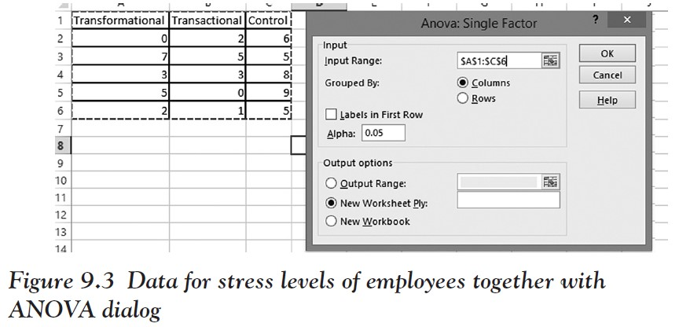
Step 1
Start a new Excel worksheet and enter the preceding data.
Ch 9: Analysis of Variance – Excel Demonstration

Slide 27
Step 2
Click on DATA, then Data Analysis, and then ANOVA: Single Factor.
We are choosing Single Factor because we have only one dependent variable (stress level) that defines three categories of independent variables (transformational, transactional, control).
Ch 9: Analysis of Variance – Excel Demonstration

Slide 28
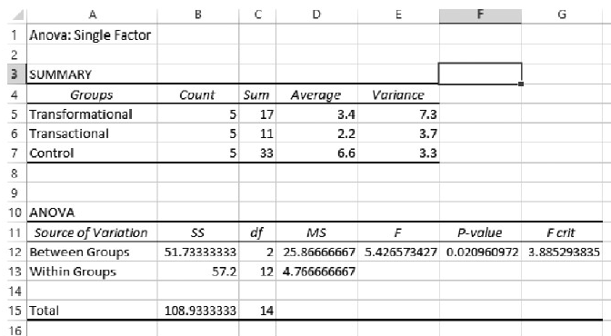
Step 3
In the dialog that comes up, select all of the data including the labels at once as shown in Figure 9.3.
Check the box called “Labels in First Row.” Notice that Alpha is automatically set to 0.05.
Click OK.
Figure 9.4 Output of the single-factor ANOVA procedure
In a review of the p-value in the between groups row, we see a p = 0.02 that is less than our alpha level of 0.05
So we know there is a significant difference in stress levels between the groups
Ch 9: Analysis of Variance – Excel Demonstration
Notes:
Now that we know there is a general difference between all the groups, we would like to run a post hoc test to determine if there is a significant difference between certain groups, like between transformational and control; or between control and transactional; and so on.
In Excel, it is difficult to do this. However, a quick and easy way is to run a two-sample t-test between the two groups that you wish to check (only do this if you have determined that there is a significant difference between all groups).

